Slide 1
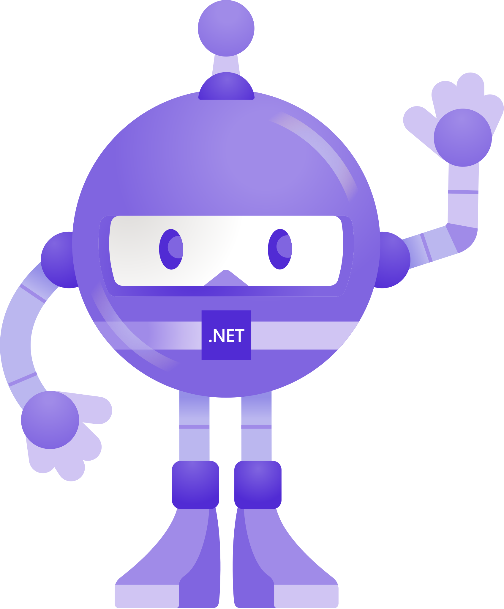
What Is ProBot?
ProBot is a Generative-AI based bot which solves the users query related to the micro-services which we use in our project.
It generate a response on the basis of the user’s query

Slide 2
Why We Need This?
We have multiple microservices and remembering details of all is not possible so for resolving that we need a bot.
In our project documents related to the microservice are scattered on 3 different platform and searching through those platform is time consuming.
For creating a big knowledge base for our project.
For enhancing the quality and accuracy of our project.

Slide 3
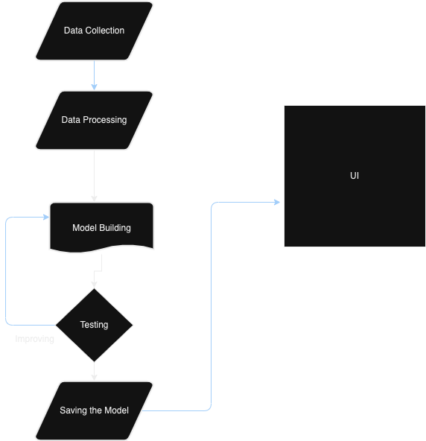
Devlopment Workflow

Slide 4
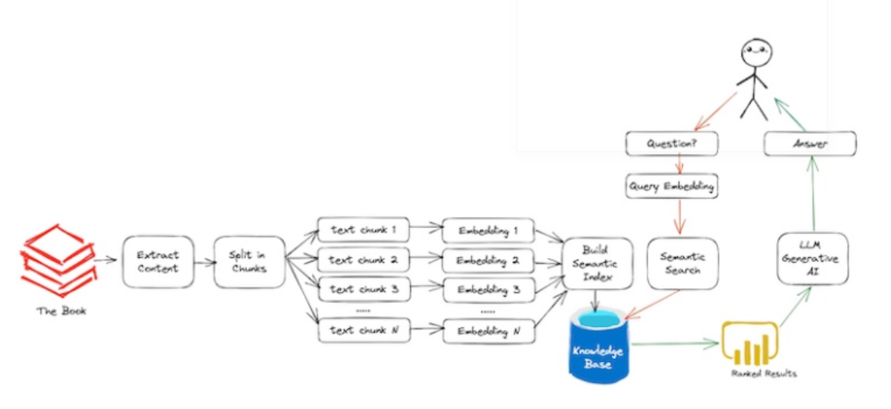
Architecture

Slide 5
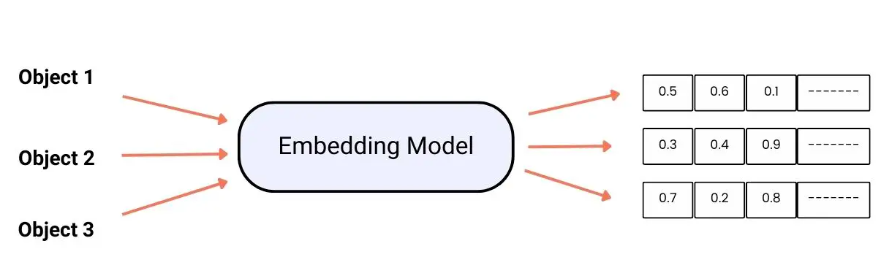
Embedding
Embedding are numerical representations of words, phrases, or sentences that capture their meaning and context.
We are using multi-qa-distilbert-cos-v1 model for embedding.
It is trained on 215M (question, answer) pairs from diverse sources.

Slide 6
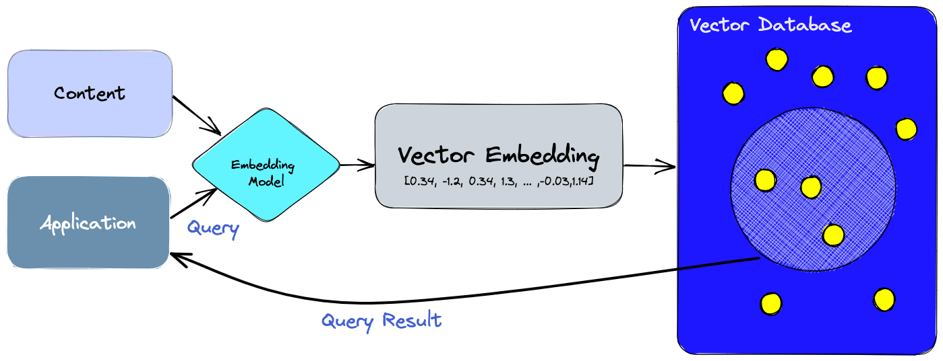
Vector Store
Vector databases offer optimized storage.
They provide easy search, high performance, scalability, and data retrieval all by comparing values and finding similarities between one another.

Slide 7
Faiss
It is developed by Facebook AI Research.
Return not just the nearest neighbor, but also the 2nd nearest, 3rd, …, k-th nearest neighbor
Search several vectors at a time rather than one (batch processing).
Store the index on disk rather than in RAM.

Slide 8
Model
We are using the LlAMA-2-7B parameter model in our project which is built by Meta
Llama 2 was pretrained on 2 trillion tokens of data from publicly available sources.
Llama 2 matches GPT-4's 85.5% accuracy. Both Llama-2-70B and GPT-4 significantly outperformed GPT-3.5-turbo

Slide 9
UI
We are using a streamlit framework for our application’s UI.
Streamlit is a free, open-source, all-python framework that enables data scientists to quickly build interactive dashboards and web apps with no front-end web development experience required.
It provides great UI element and clean interface.

Slide 10
Advantage of the Architecture
Flexible
Easy to update the knowledge hub
No need of training
Save time
No special skill set required for updation

Slide 11
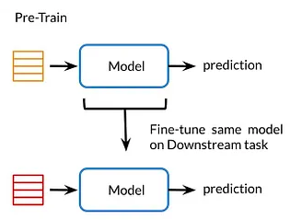
Alternative Method
( Fine Tune)

Slide 12
Disadvantage of Approach-2
Special Skill set is required for updation
Not Flexible
High Training Cost
High training time
Hard to update knowledge

Slide 13
Benefits
Save time
Reduced Dependencies on Manual Assistance
Enhanced Productivity
Knowledge Hub
Improved Decision Making

Slide 14
Thank You

